Slide 1
Microprogrammed control unit

Slide 2
Control Unit
Control unit initiates sequence of microoperation, to control the flow of program execution
Two major types of Control Unit
Hardwired Control :
The control logic is implemented with gates, F/Fs, decoders, and other digital circuits
Fast operation, - Wiring change(if the design has to be modified)
Microprogrammed Control :
The control information is stored in a control memory, and the control memory is programmed to initiate the required sequence of microoperations
Any required change can be done by updating the microprogram in control memory, - Slow operation

Slide 3
Control Word
The control unit initiates a series of sequential steps of microoperations. During any given time, certain microoperations are to be initiated, while others remain idle.
The control variables at any given time can be represented by a string of 1’s and 0’s.
Active state of control variable is 1 or 0 depends on application
Microprogrammed Control Unit
A control unit whose binary control variables are stored in memory (control memory)
Microinstruction : Control Word in Control Memory
The microinstruction specifies one or more microoperations

Slide 4
Microprogram
A sequence of microinstruction
Static microprogramming : Control Memory = ROM
Control words in ROM are made permanent during the hardware production.
Control units reads the microprogram from ROM
We can not alter microprogram
Dynamic microprogramming : Control Memory = RAM
RAM can be used for writing (to change a writable control memory)
Microprogram is loaded initially from an auxiliary memory such as a magnetic disk

Slide 5
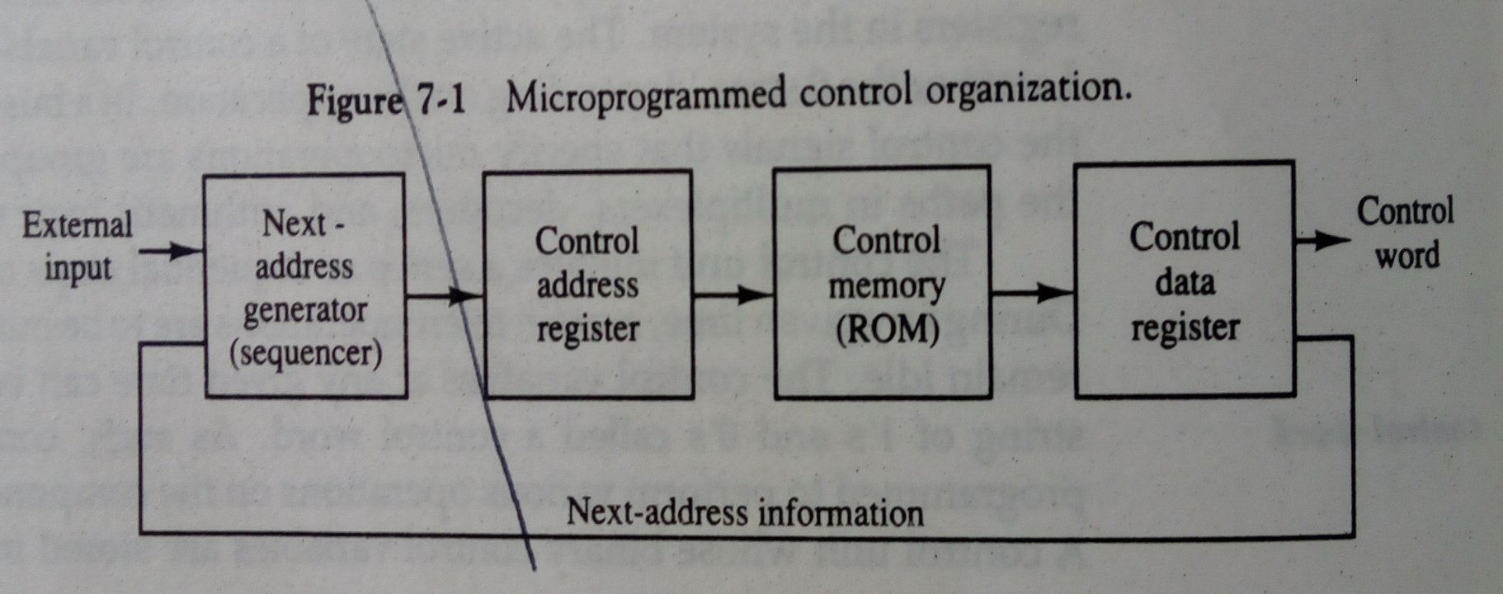

Slide 6
Control Memory
A computer that employs a microprogrammed control unit will have two separate memories: a main memory and a control memory.
The control memory holds a fixed microprogram that can not be altered by the occasional user.
The microprogram consists of microinstructions that specify various internal control signals for execution of register microoperation.
Microinstructions generates the microoperations to fetch instruction from main memory; to evaluate the effective address, to execute the operation specified by the instruction, and to return control to the fetch of next instruction.

Slide 7
Microprogrammed Control Organization
External
input
Control
word
Next-address generator (Sequencer)
Control address register(contains address of micro instructions)
Control memory
(ROM) (stores microprogram)
Control
data
Register(contains instruction to be executed)
Next-address information

Slide 8
Microprogrammed control Organization :
1) Control Memory
A memory is part of a control unit : contains Microprogram
Computer Memory (employs a microprogrammed control unit)
Main Memory : for storing user program (Machine instruction/data)
Control Memory : for storing microprogram (Microinstruction)
2) Control Address Register
Specify the address of the microinstruction
3) Sequencer (= Next Address Generator)
Determine the address sequence that is read from control memory
Next address of the next microinstruction can be specified several way depending on the sequencer input

Slide 9
4) Control Data Register (= Pipeline Register )
Hold the microinstruction read from control memory
Allows the execution of the microoperations specified by the control word simultaneously with the generation of the next microinstruction
Two phase clock is required one for address register and one for data register
RISC Architecture Concept
RISC(Reduced Instruction Set Computer) system use hardwired control rather than microprogrammed control

Slide 10
Address Sequencing
Address Sequencing = Sequencer : Next Address Generator
Selection of address for control memory
How we can generate next instruction address
Routine
Microinstruction are stored in control memory in groups
Each computer instruction has its own routine
When you turn on computer initial address is loaded in control address register
There will be various routines followed after that such as fetch routine(to load instruction in instruction register), than routine to determine effective address of operand, after that microinstructions to execute instruction will be performed

Slide 11
Mapping
Instruction Code → Address in control memory(where routine is located)
Address Sequencing Capabilities : control memory address(four approaches of generating address for next instruction to be executed)
1) Incrementing of the control address register by 1(incase of sequential program)
2) Unconditional branch or conditional branch, depending on status bit conditions
3) Mapping process ( bits of the instruction address for control memory )
4) A facility for subroutine call and return

Slide 12
Address Sequencing
Instruction code
Mapping
logic
Status
bits
Branch
logic
Mux
select
Multiplexer
Subroutine
register
(SBR)
Clock
Control address register
(CAR)
Incrementer
Control memory
Select a status bit
Branch address
Microoperations

Slide 13
Selection of address for control memory :
Multiplexer
① CAR Increment
② JMP/CALL
③ Mapping
④ Subroutine Return
CAR : Control Address Register
CAR receive the address from
4 different paths
1) Incrementer
2) Branch address from
control memory
3) Mapping Logic
4) SBR : Subroutine Register
SBR : Subroutine Register
Return Address can not be stored
in ROM
Return Address for a subroutine is
stored in SBR
② ③ ④ ①

Slide 14
we have to fetch the instruction from control memory , address for instruction we get from CAR
There are four ways to store the address in CAR so we use 4*1 multiplexer
First is from instruction code, where using mapping logic we will receive address bits and store it in CAR
Second is incrementer , when instructions are in sequence CAR will simply be incremented
Third is when we have subroutine in that case we have to save the return address
Forth is branching so we have to load branching address in CAR

Slide 15
Now which of four will be selected depends on MUX select
Control memory send status bit to select line, if regular instruction than we just need to increment the address so input 1 will be selected
If subroutine than input 4 is selected so on

Slide 16
1. Subroutine
Subroutines are programs that are used by other routines
Subroutine can be called from any point within the main body of the microprogram
Microinstructions can be saved by subroutines that use common section of microcode
Subroutine must have a provision for
storing the return address during a subroutine call
restoring the address during a subroutine return
Last-In First Out(LIFO) Register Stack

Slide 17
2. Conditional/unconditional Branching
Status Bits
Control the conditional branch decisions generated in the Branch Logic
Status bit will be checked before branching to the given address
There are several status bits such as zero, signed bit, overflow
For zero flag we will check we need if all status bits are 0 or not if condition is satisfied than we will load address 1010(next address to jump on) to CAR
Branch Logic
Test the specified condition and Branch to the indicated address if the condition is met ; otherwise, the control address register is just incremented.
Status Bit Test and Branch Logic:
4 X 1 Mux Input Logic

Slide 18
Status bits in a microprogram control unit are special binary indicators or flags that provide information about the state or condition of the processor during the execution of microinstructions.
These status bits help in making decisions and controlling the flow of microprogram execution.
The specific status bits can vary depending on the architecture and design of the microprogrammed control unit. Here are some common status bits

Slide 19
Zero Flag (Z): This flag is set if the result of an operation is zero. It helps in making decisions based on whether a value is zero or non-zero.
Sign Flag (S): Indicates the sign of the result. For example, it may be set if the result of an operation is negative.
Carry Flag (C): Used in arithmetic operations to indicate whether there was a carry-out from the most significant bit. It's essential for multi-byte addition or subtraction.
Overflow Flag (V or O): Indicates whether an arithmetic overflow has occurred. It's helpful for detecting errors in signed arithmetic

Slide 20
3. Mapping of Instruction :
4 bit Opcode = specify up to 16 distinct instruction
Mapping Process : Converts the 4-bit Opcode to a 7-bit control memory address
1) Place a “0” in the most significant bit of the address
2) Transfer 4-bit Operation code bits
3) Clear the two least significant bits of the CAR
Mapping Function : Implemented by Mapping ROM or PLD
Control Memory Size : 128 words (= 2⁷)
Opcode
Computer Instruction
1 0 1 1 Address
Mapping bits
0 x x x x 0 0
Microinstruction Address
0 1 0 1 1 0 0

Slide 21
Microprogram Example
Once we will configure computer and its microprogrammed control unit than we have to generate microcode for control memory, process is called microprogramming
Computer Configuration :
2 Memory : Main memory(instruction/data), Control memory(microprogram)
Data written to memory come from DR, and Data read from memory can go only to DR
4 CPU Register and ALU (associated with main memory) : DR, AR, PC, AC, ALU
DR can receive information from AC, PC, or Memory (selected by MUX)
AR can receive information from PC or DR (selected by MUX)
PC can receive information only from AR
ALU performs microoperation with data from AC and DR
2 Control Unit Register (associated with control memory) : SBR, CAR

Slide 23
Main memory can hold total 2048 word, 2048 = 2^{11,} So we will need 11 bit for address here . We have size of address register and program counter is 11
Each word is of 16 bit so data register size is 16 bit
Control memory can hold 128 words, 128 = 2⁷, so we need 7 bit address here. So we have size of CAR and SBR as 7
Each word here is of 20 bits
To transfer information between registers we can use common bus or we can use MUX, here we have used MUX

Slide 24
Data register receives information in three ways 1. from address register, 2. from accumulator, 3. from memory
Address register receives information in two ways 1. from data register 2. from program counter
Program counter receives information from address register
Address register specify the address with help of that we can access the information from memory
ALU performs arithmetic and logic operation on the content of AC and DR, result will be stored in AC
CAR receives input from AR

Slide 25
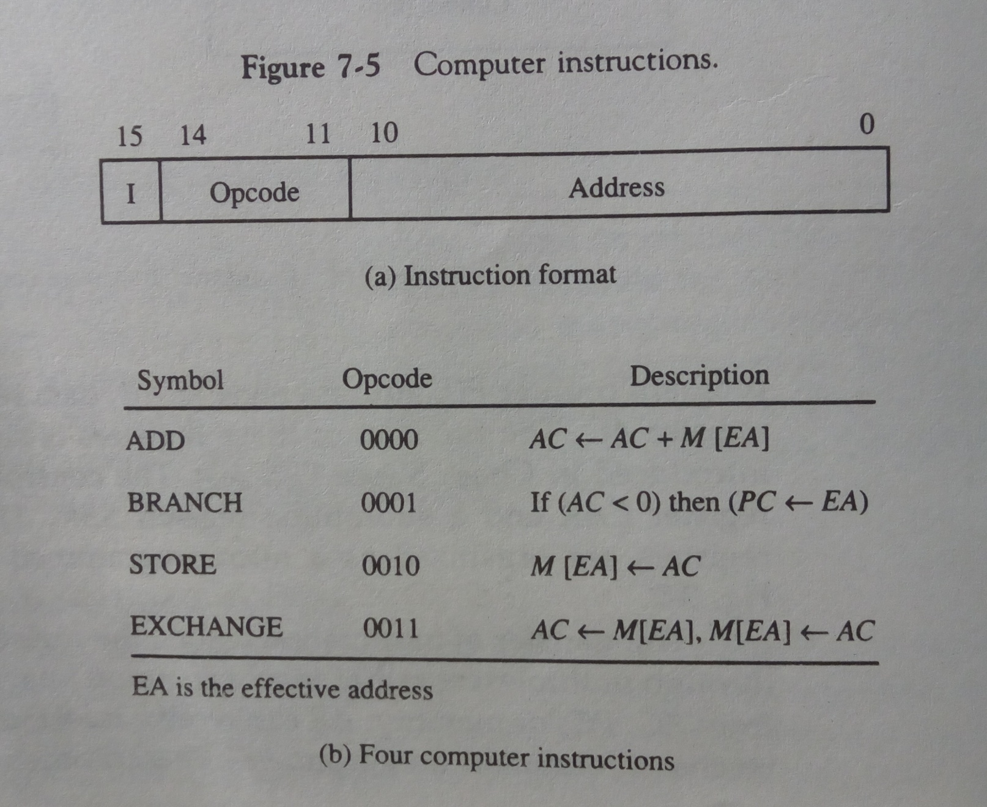
Instruction format & computer instruction

Slide 26
Machine instruction format
Size of instruction:- 16 bits
11 bit (0-10):- address
4 bit (11-14):-opcode
1 bit (15):- addressing mode
As 4 bit opcode we can define total 16 microoperations here we have taken 4 operations for simplicity
ADD(0), BRANCH(1),STORE(2),EXCHANGE(3)
ADD:- add the content of accumulator with operand store in memory , it can be extracted by EA (effective address)
BRANCH:- if content of AC is negative (most significant bit 1) than EA is transferred to PC

Slide 27
STORE:- store content of AC in memory at location given by EA
EXCHANGE:- exchange the content of memory and AC
each computer instruction must be microprogrammed. (multiple steps followed to perform single instruction such as ADD R1,R2.
Each machine instruction is needs to be represented by microinstruction, which is represented by control word.
In order not to complicate the microprogramming example, only four instructions are considered here.
It should be realized that 12 other instructions can be included and each instruction must be microprogrammed by the procedure outlined.

Slide 28
Microinstruction Format:-
Size of instruction:- 20 bits (4 main function part)
AD(7 bits ):- address field
F1,F2,F3(3 bits each):- microoperation field
CD(2 bit):- condition for branching
BR(2 bit):- branch field
Each microoperation field is of 3 bits so can have 8-operations each

Slide 29
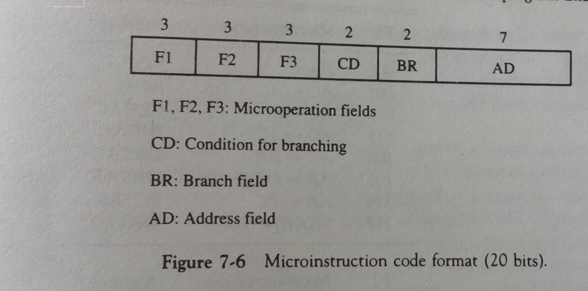
Microinstruction code format

Slide 30
Microoperation field(F1,F2,F3)
The microoperations are subdivided into three fields of three bits each.
The three bits in each field are encoded to specify seven distinct microoperations as listed in Table .
This gives a total of 21 microoperations.
No more than three microoperations can be chosen for a microinstruction, one from each field.
If fewer than three microoperations are used, one or more of the fields will use the binary code 000 for no operation.
As an illustration, a microinstruction can specify two simultaneous microoperations from F2 and F3 and none from Fl.

Slide 31
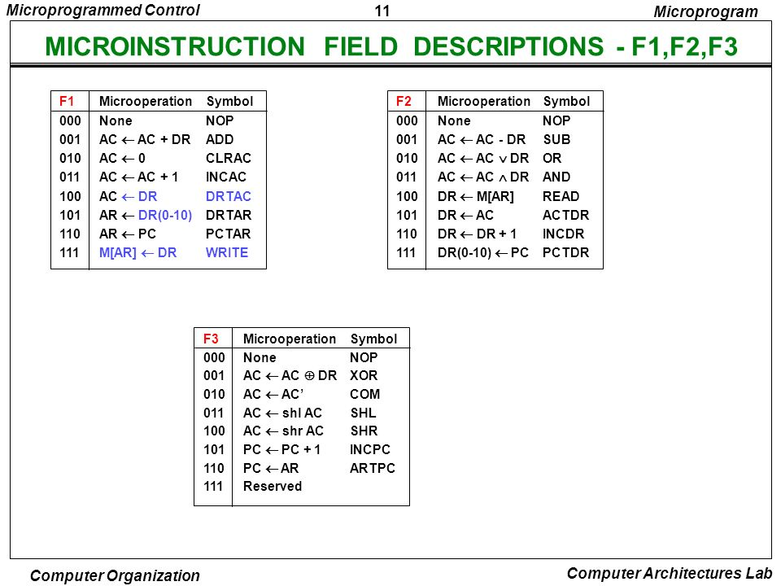
Symbol & code for microinstruction fields

Slide 32
The nine bits of the microoperation fields will then be 000 100 101.
It is important to realize that two or more conflicting microoperations cannot be specified simultaneously.
For example, a microoperation field 010 001 000 has no meaning because it specifies the operations to clear AC to 0 and subtract DR from AC at the same time.

Slide 33
condition field
The CD (condition) field consists of two bits which are encoded to specify four status bit conditions as listed in Table .
This field selects status bit for condition.

Slide 34
Size of condition field is 2 bits so we can have 4 combinations
For 00 no condition will be checked, condition will always be true
For 01 its addressing mode where we will check most significant bit of DR, if it is 1 condition is TRUE
For 10 its signed bit so we will check most significant bit of AC, if it is 1 condition is TRUE
For 11 its zero flag if all bits of AC are zero that means condition is TRUE

Slide 35
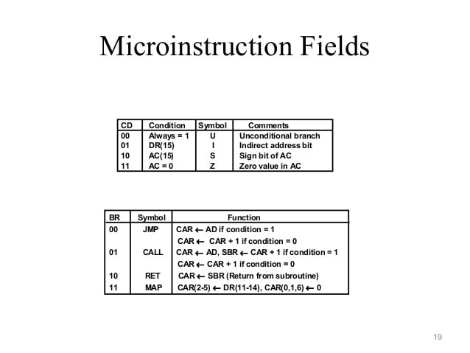

Slide 36
Branch field
The BR (branch) field consists of two bits. It is used, in conjunction with the address field AD, to choose the address of the next microinstruction.

Slide 37
2 bit Branch Fields : BR
00 : JMP
Condition = 0 :
Condition = 1 :
(based on U,I,Z,S)
01 : CALL
Condition = 1 :
Condition = 0 :
10 : RET
11 : MAP
1
2
1
2
3
4
Save Return Address
Restore Return Address

Slide 38
7 bit Address Fields : AD
128 word : 128 X 20 bit

Slide 39
Symbolic Microinstructions
Symbolic Microinstruction
① Label Field : Terminated with a colon ( : ), may or may not be empty
② Microoperation Field : one, two, or three
symbols, separated by commas
③ CD Field : U, I, S, or Z
BR Field : JMP, CALL, RET, or MAP
① ② ③ ④ ⑤

Slide 40
⑤ AD Field (address of next instruction to be executed)
a. Symbolic Address : Label ( = Address )
b. Symbol “NEXT” : next address
c. Symbol “RET” or “MAP” : AD field = 0000000
ORG : Pseudo instruction(define the origin, or first address of routine)

Slide 41
Fetch (Sub)Routine
Memory Map(128 words) :
Address 0 to 63 : Routines for the 16 instruction
Address 64 to 127 : Any other purpose( Subroutines : FETCH, INDRCT)
Microinstruction for FETCH Subroutine
Fetch Subroutine : address 64
Opcode Fetch
Opcode Decode
Operand Address
Mapping
Instruction Format
15 14 11 10 …. … 0
I Opcode Address

Slide 42
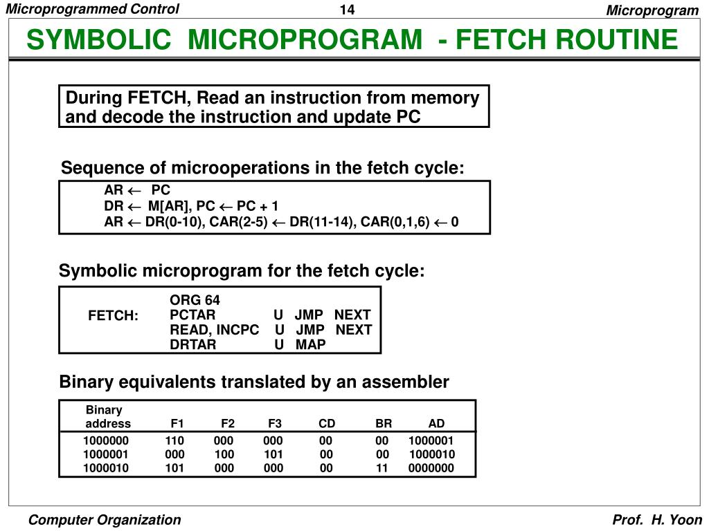

Slide 43
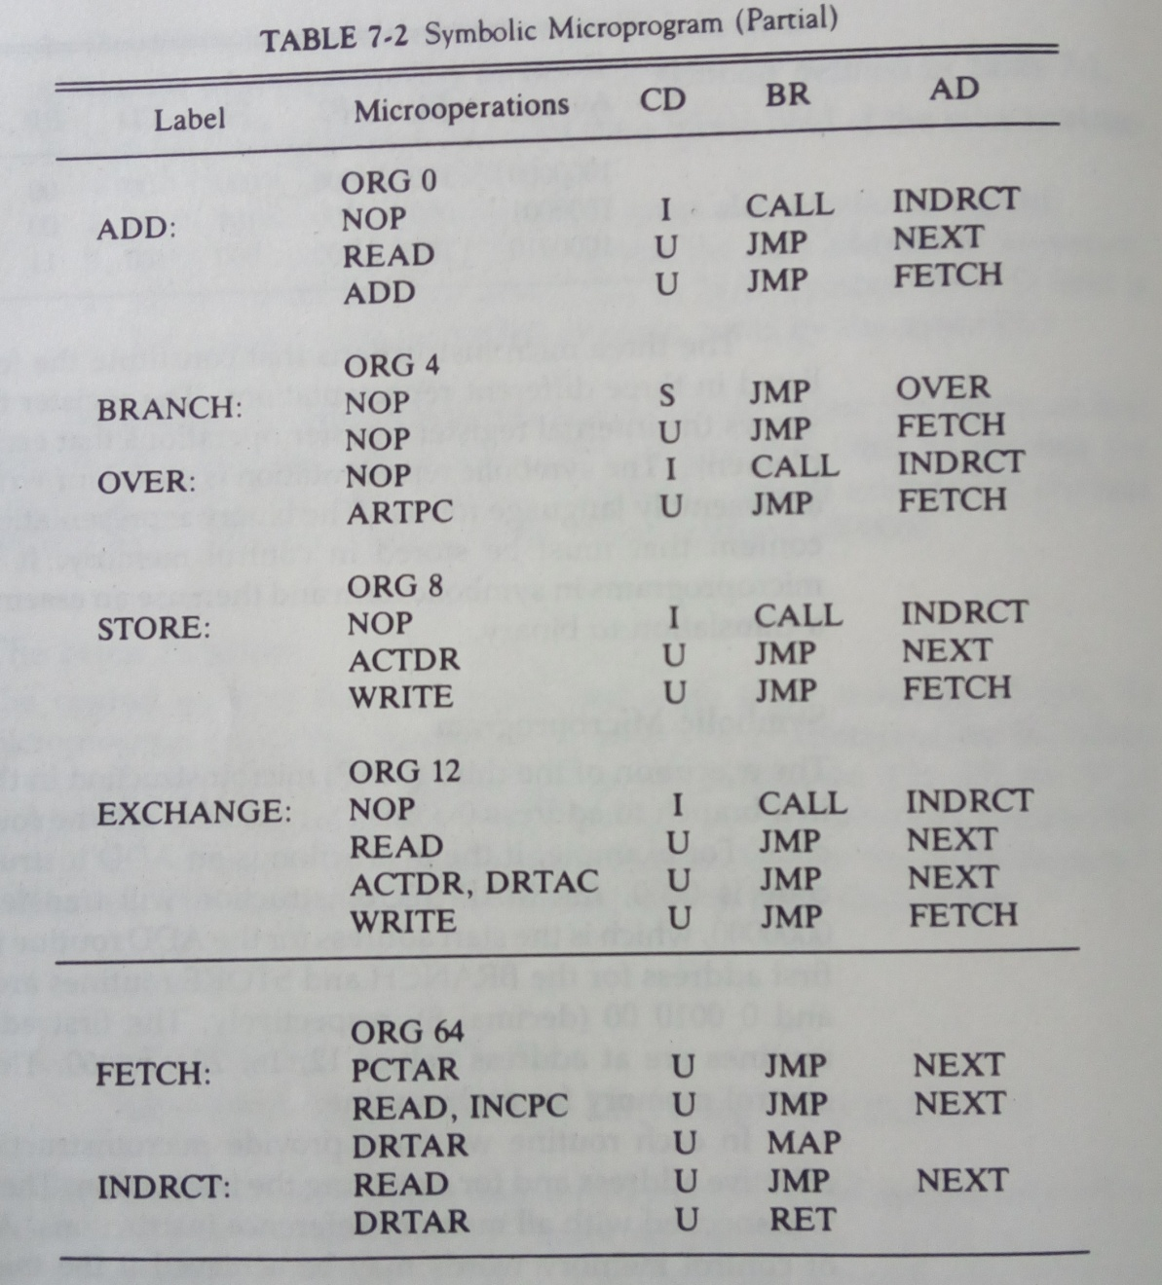

Slide 44
